Slide 1
SVX Data Flow
Steve Hoover
Aug 2013

Slide 2
Agenda
Transaction-Level Modeling in SVX
The meaning of X
Examples
Toy Ring
Pipeline logic
Latch-based pipeline (Synchronous ELastic Flow – SELF)
Takeaway

Slide 3
Transactions and Data Flow in SVX
Logic is expressed in the context of transactions which traverse pipelines and flows
SVXpp manages the staging/progression of signals through the pipelines/flows as required based on producing/consuming stages. SVXpp generates all flops/latches
Transaction flow can be expressed independently from the logic of the transaction
Transaction flow can be defined in libraries that are independent of the transaction logic that occurs within the flow. Note that generic library capabilities are purely proof-of-concept at this point and are not recommended for broad deployment.
Flow elements include FIFOs, queues, arbiters, back-pressure, bypass, etc.
The transaction logic is bucketed to pipelines and pipestages defined by the flow; logic can be re-bucketed w/ no impact to behavior

Slide 4
Flow Example
FIFO
QUEUE
free-flow
pipeline
backpress.
pipeline
free-flow
pipeline
free-flow
pipeline
Bypass
Transaction Logic
comb
comb
comb
comb
comb
comb
comb
comb
0
bypass

Slide 5
Mapping Logic to Pipeline/Pipestage
FIFO
QUEUE
free-flow
pipeline
backpress.
pipeline
free-flow
pipeline
free-flow
pipeline
Bypass
comb
comb
comb
comb
comb
comb
comb
comb
0
bypass

Slide 6
Design Changes
FIFO
QUEUE
free-flow
pipeline
backpress.
pipeline
free-flow
pipeline
free-flow
pipeline
Bypass
comb
comb
comb
comb
comb
comb
comb
comb
0
bypass

Slide 7
Design Changes
FIFO
QUEUE
free-flow
pipeline
backpress.
pipeline
free-flow
pipeline
free-flow
pipeline
Bypass
comb
comb
comb
comb
comb
comb
comb
comb
Old FIFO contents
0
bypass
New FIFO contents

Slide 8
Proof of Concept for Library Development in SVX
M4 macro-preprocessor in front of SVX
Provides easy solution for parameterization, replication, etc.
Not a long-term solution; very messy syntax
Provides proof-on-concept prior to native SVX language features
Created back-pressured pipeline
Each stage of the pipeline is a unique SVX (non-backpressured) pipeline
Signals pulled from one stage/pipeline to the next through a gated flop or recirculating mux as needed by the transaction logic.
This is done with wildcarded signals ($ANY) as inputs/outputs of SV expressions. Eg:
which says, recirculate the transaction from the previous cycle, or accept the transaction from the previous stage. (Granted, I haven’t explained the syntax.)
These expressions construct a data flow graph which could be searched to find and pull transaction fields (signals) through the flow.

Slide 9
Performance Modeling in SVX
SVX data flow makes it feasible to create concise abstract models
Models are synthesizable, enabling emulation of abstract models
Other SVX capabilities, not discussed in this presentation, assist in bridging the gap between abstract and RTL details
This enables a radical methodology change where performance models and models for architectural exploration could exist as part of the same code pool that provides RTL
Perf/arch models evolve into RTL
Validation is enabled earlier
Perf models and RTL are better aligned
Mix and match of “RTL” and perf components makes it easier to isolate the performance contributions of different “RTL” components

Slide 10
Agenda
Transaction-Level Modeling in SVX
The meaning of X
Examples
Toy Ring
Pipeline logic
Latch-based pipeline (Synchronous ELastic Flow – SELF)
Takeaway

Slide 11
Don’t-Care Injection w/ SVX
Xs have two meanings:
Don’t-Know: We don’t know what value the signal has. Could be 0 or 1.
Don’t-Care: It doesn’t matter what value the signal has. Not visible impact either way.
If we Don’t-Know, we must ensure that we Don’t-Care – that’s what determinism validation is all about.
SVX makes it easy to provide Don’t-Care information as a reflection of design intent. Eg: fields of an invalid transaction.
SVXpp can generate SV code capable of injecting Don’t-Cares.
Catch violations of design intent that would otherwise go undetected because they don’t manifest as real functional bugs.
Filter out noise for debug (next 2 slides).

Slide 12
Determinism Validation
Determinism validation ensures that Don’t-Know initial states are eliminated by cold reset (and are therefore Don’t-Cares).
With no distinction in simulation between Don’t-Know and Don’t-Care, X-injection for Don’t-Cares would get in the way of determinism validation, so it is disabled.
In other 4-state simulations, Xs are Don’t-Cares and X-injection is enabled. X-propagation ensures that Don’t-Cares really do not get consumed.

Slide 13
Agenda
Transaction-Level Modeling in SVX
The meaning of X
Examples
Toy Ring
Pipeline logic
Latch-based pipeline (Synchronous ELastic Flow – SELF)
Takeaway

Slide 14
Ring Example
data
data
valid
valid
backpressure
backpressure
valid
valid
dest
dest
valid
dest
data
data
valid
dest
data
data
data
data
valid
valid
backpressure
backpressure
valid
valid
dest
dest
valid
dest
data
data
valid
dest
data
data
data
data
valid
valid
backpressure
backpressure
valid
valid
dest
dest
valid
dest
data
data
valid
dest
data
data
data
data
valid
valid
backpressure
backpressure
valid
valid
dest
dest
valid
dest
data
data
valid
dest
data
data

Slide 15
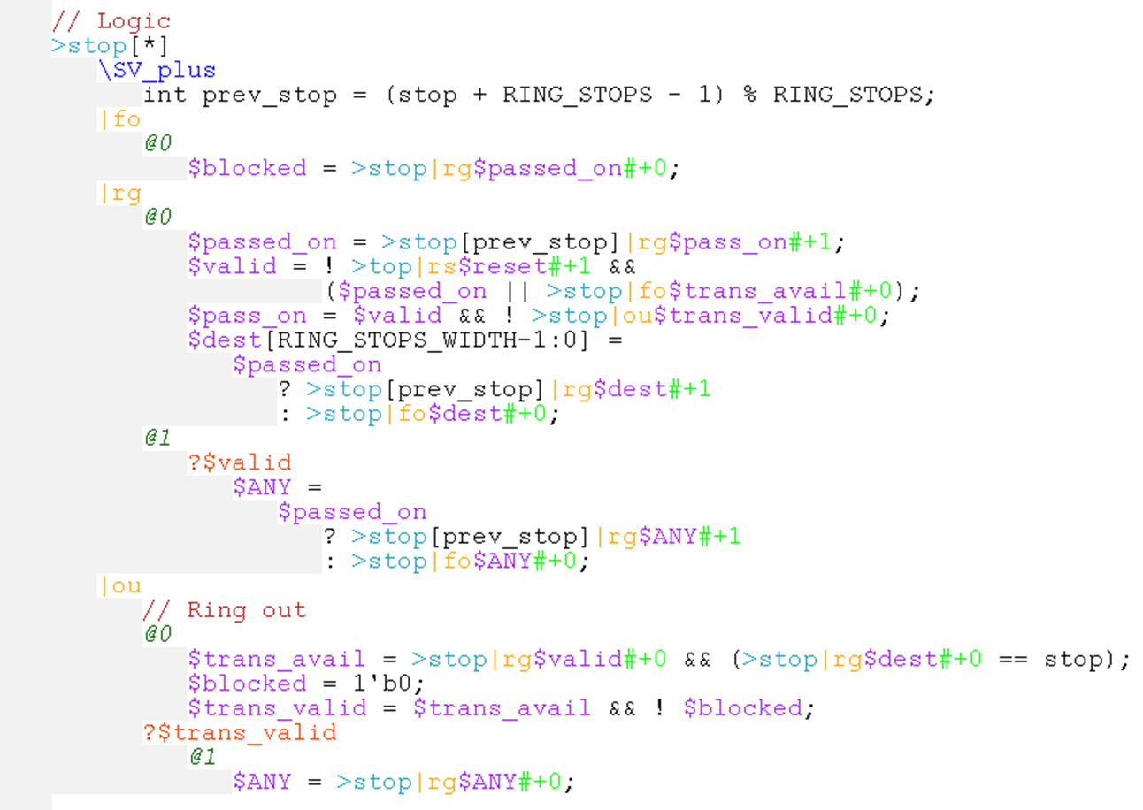
Ring code (expanded from invocation)
|ou
>stop[*]:
|rg
|fo
data
valid
backpressure
valid
dest
valid
dest
data
data
@0
@1
@2

Slide 16
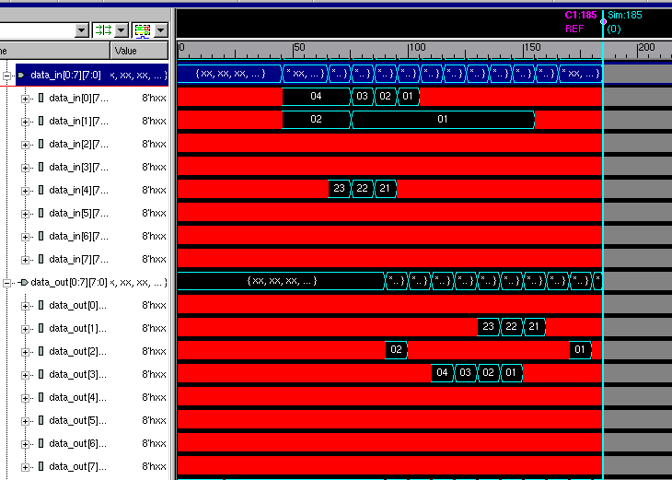
Simulation

Slide 17
Ring + FIFOs
(fllop-based, w/ bypass
and single encoded
head/tail pointer mask)
data
data
valid
valid
backpressure
backpressure
valid
valid
dest
dest
valid
dest
data
data
valid
dest
data
data
data
data
valid
valid
backpressure
backpressure
valid
valid
dest
dest
valid
dest
data
data
valid
dest
data
data
data
data
valid
valid
backpressure
backpressure
valid
valid
dest
dest
valid
dest
data
data
valid
dest
data
data
data
data
valid
valid
backpressure
backpressure
valid
valid
dest
dest
valid
dest
data
data
valid
dest
data
data

Slide 18
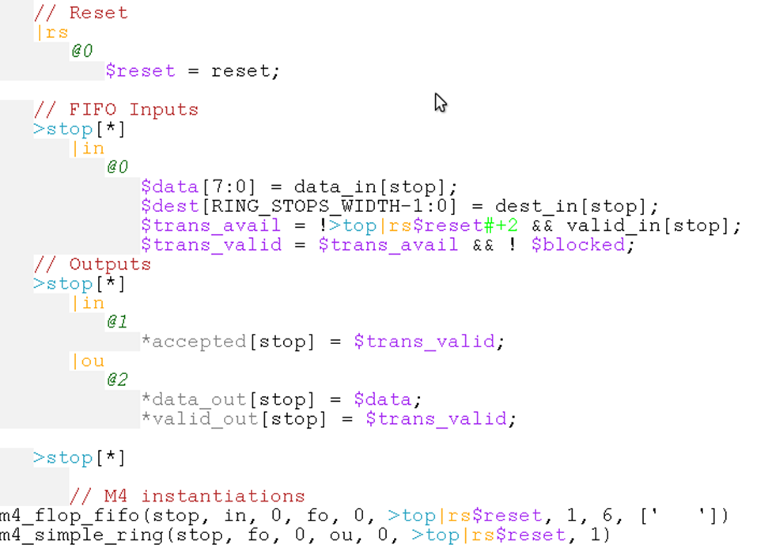
Ring + FIFOs SVX Code w/ SV Hookup
SV I/O hookup
Ring/FIFO instantiation

Slide 19
Scenario
Silent data corruption too high, determined late in the project
Decide to cover complete data path through FIFOs and ring with single parity bit. Generate parity prior to FIFO, check at ring egress.
Extra cycle required for parity generation.

Slide 20
Ring + FIFOs SVX Code w/ SV Hookup
Code change:
add $parity = …;
add $error = … $parity …;
0 → 1 (to feed FIFO 1 cycle later)
@1 (to consume backpressure 1 cycle later) (caught by SVXpp)
~1 minute to modify & debug (addition of parity signal, not parity logic)
vs. ~100 lines of RTL change in generated RTL – bugs, bugs, bugs if done by hand!!!

Slide 21
Agenda
Transaction-Level Modeling in SVX
The meaning of X
Examples
Toy Ring
Pipeline logic
Latch-based pipeline (Synchronous ELastic Flow – SELF)
Takeaway

Slide 22
Pipeline Logic
bypass
swizzle
decode
decode
decode
decode
decode
decode
decode
decode
decode
decode
convert
data
data
en
data
data
en
data
data
en
data
data
en
data
data
valid.
valid.
valid.
valid.
valid.
en
valid.
en
backpress.
backpress.
backpress.
backpress.
backpress.
backpress.

Slide 23
Pipeline Logic (implementation)
swizzle
decode
decode
decode
decode
decode
decode
decode
decode
decode
decode
convert
data
data
en
data
data
en
data
data
en
data
data
en
data
data
valid.
valid.
valid.
valid.
valid.
en
valid.
en
backpress.
backpress.
backpress.
backpress.
backpress.
backpress.

Slide 24
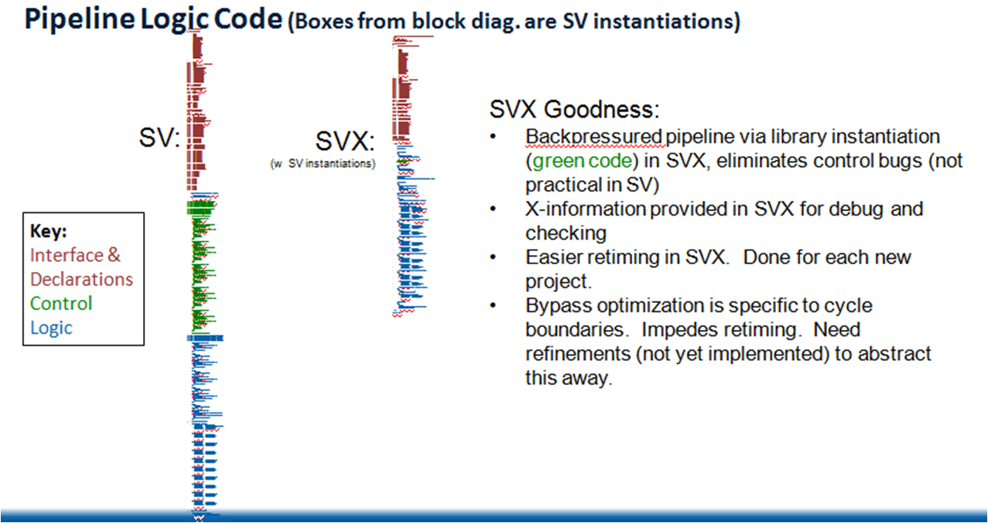

Slide 25
Agenda
Transaction-Level Modeling in SVX
The meaning of X
Examples
Toy Ring
Pipeline logic
Latch-based pipeline (Synchronous ELastic Flow – SELF)
Takeaway

Slide 26
Synchronous ELastic Flow (SELF)
Design style explored by Michael Kishinevsky, et. al., in Intel’s Strategic CAD Lab
In SELF, transactions flow through pipelines that are backpressured at each latch, not at each flop, allowing each latch to hold a transaction, providing ~2x capacity
Abandoned several years ago, mainly because it was hard to migrate existing RTL to SELF
With SVX this would be the flick of a switch
Created a proof-of-concept SELF pipeline
(It’s actually the same code used to create the flop-based backpressured pipeline, using M4 to parameterize)

Slide 27
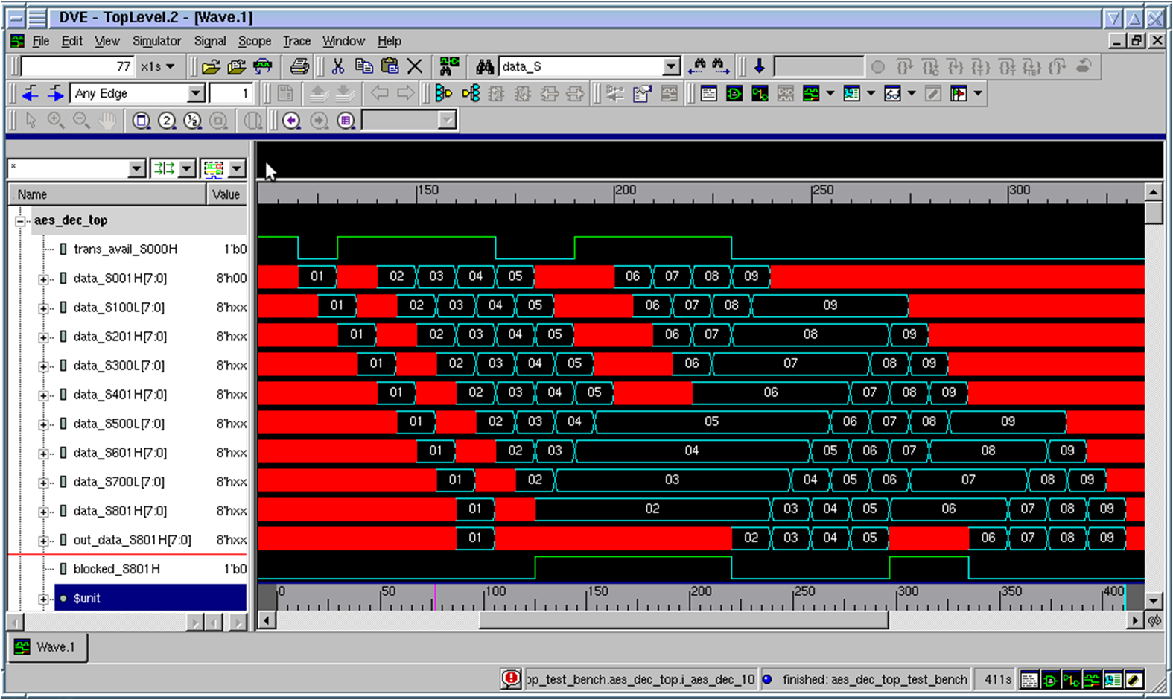
Data flowing through a SELF pipeline

Slide 28
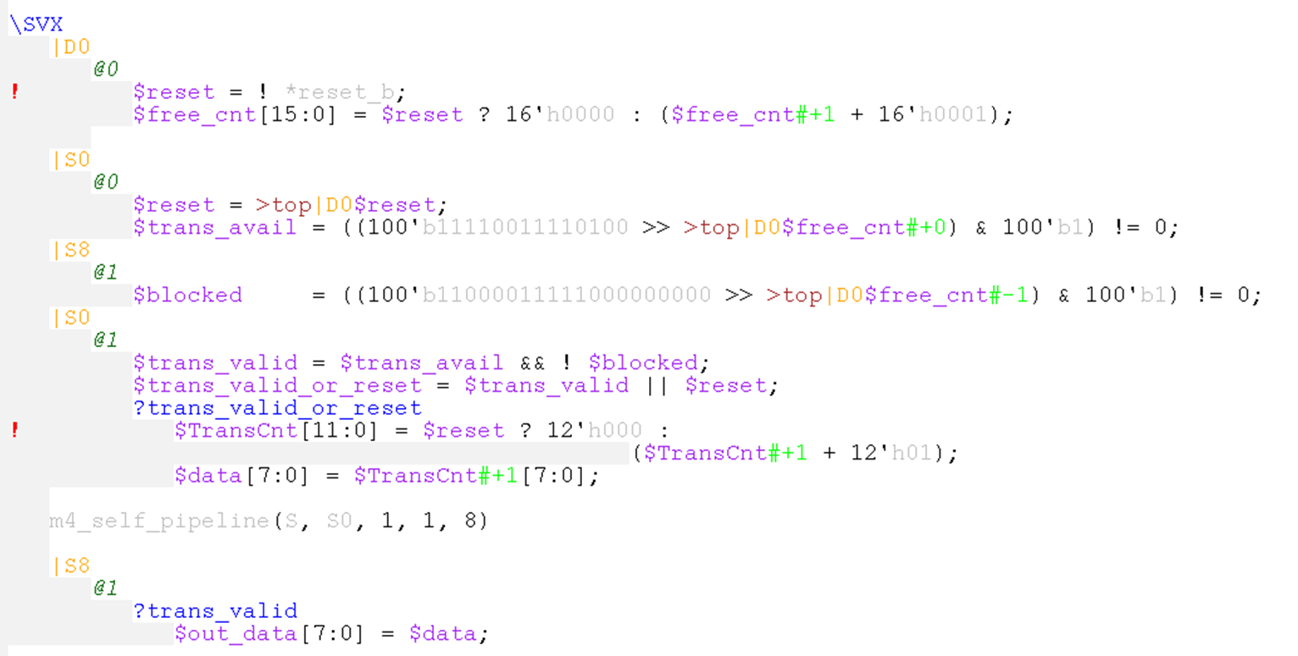
Code (w/o explanation)
This is the complete code and testbench generating the previous waveform (excluding generic library code and clock/reset inputs)
Testbench
Transaction In
Logic
Transaction
Out

Slide 29
Pipeline Example and SELF
Conversion to SELF pipeline trivial in SVX (w/ M4 library)
Just change this instantiation:
m4_bp_pipeline(S, S0, 1, 1, 8)
To this:
m4_self_pipeline(S, S0, 1, 1, 8)
Transparency can be used to reduce latency (by moving A-phase instantiations to B-phase).
Provides 5 free cycles of backpressure storage, deemed beneficial by designer.
Note that SELF has implication to SCAN methodology w/ 2 states per “flop”.
Note that this example has not been synthesized, just simulated.

Slide 30
Agenda
Transaction-Level Modeling in SVX
The meaning of X
Examples
Toy Ring
Pipeline logic
Latch-based pipeline (Synchronous ELastic Flow – SELF)
Takeaway

Slide 31
Takeaway
Logic design does not have to be a painful experience ☺
Significant potential today, w/ small fraction of envisioned feature set.
Huge potential benefit w/ more investment.
We’re past the initial hump. An hour of investment will save more than an hour of project effort… on one project alone.
Need:
Investment
Industry/academic collaboration, open-sourcing
You!

